Slide 1
SQL Database in Azure

Slide 2
What is Azure SQL?
Core RDBMS SQL Server functionality in the cloud. High availability, low learning curve, inexpensive starting point, elastic capacity, low management overhead.
SQL Database is a relational database service in the cloud based on the market-leading Microsoft SQL Server engine, with mission-critical capabilities. SQL Database delivers predictable performance, scalability with no downtime, business continuity and data protection— all with near-zero administration

Slide 3
What you get:
Tables, Views, Stored Procedures, Security Roles and Users
Limited T-SQL functionality
Automatic backups
Auditing
Monitoring
Geo-replication
Client tools you already know + online administration

Slide 4
What features are NOT supported? some
BACKUP and RESTORE statements
Common language runtime (CLR)
Database mirroring
Database snapshots
DDL statements (Some)
DDL triggers (Database only)
DML statements (Some)
Restore database from backup (From Built-in Only)
SQL Server Reporting Services (SSRS)
…………………..
Notes:
Allow other service inside the datacenter to access server but from outside needs a firewall rules

Slide 5
Backup and Restore
You can use point-in-time restore to return a database to an earlier state, as far back as 35 days. You can configure long-term backup retention to store backups in a secure vault for up to 10 years.

Slide 6
Azure SQL Database logical server
An Azure SQL Database logical server acts as a central administrative point for multiple databases.
In SQL Database, a server is a logical container that is distinct from a SQL Server instance that you may be familiar with in the on-premises world.
Specifically, the SQL Database makes no guarantees regarding location of the databases in relation to their logical servers. They may not be in the same physical server
All tools expect a server to connect to DB
Notes:
Logical container has a name ..

Slide 7
Azure SQL Database logical server
Is created within an Azure subscription, but can be moved with its contained resources to another subscription
Is the parent resource for databases, elastic pools, and data warehouses
Provides a namespace for databases, elastic pools, data warehouses
Is a logical container with strong lifetime semantics - delete a server and it deletes the contained databases, elastic pools, data warehouses

Slide 8
Azure SQL Database logical server
Databases, elastic pools within a server inherit access rights from the server
Server-level principal logins can manage all databases on a server can contain logins similar to those in instances of SQL Server on your premises that are granted access to one or more databases on the server, and can be granted limited administrative rights.
Is restricted by a quota within the parent subscription (six servers per subscription

Slide 9
Azure SQL Database logical server
Provides the scope for management policies that apply to its databases: logins, firewall, audit, threat detection, etc.
Provides a connection endpoint for database access (.database.windows.net)

Slide 10
Azure SQL Database logical server
Authentication and authorization: Azure SQL Database supports SQL authentication and Azure Active Directory Authentication Windows Authentication is not supported
TCP/IP: Only TCP/IP connections are allowed.
SQL Database firewall: To help protect your data, a SQL Database firewall prevents all access to your database server or its databases until you specify which computers have permission

Slide 11
Single Database vs Elastic Database
For many businesses and apps, being able to create databases and dial single database performance up or down on demand is enough, especially if usage patterns are relatively predictable. But if you have unpredictable usage patterns, it can make it hard to manage costs and your business model.
Elastic database pools in SQL Database solve this problem.

Slide 12
Single Database vs Elastic Database
The concept is simple.
You allocate performance to a pool,
Pay for the collective performance of the pool rather than single database performance.
You don’t need to dial database performance up or down.
The databases in the pool, called elastic databases, automatically scale up and down to meet demand.
Elastic databases consume but don’t exceed the limits of the pool, so your cost remains predictable even if database usage doesn’t.

Slide 13
Pricing
https://azure.microsoft.com/en-us/pricing/details/sql-database/?b=16.50

Slide 14
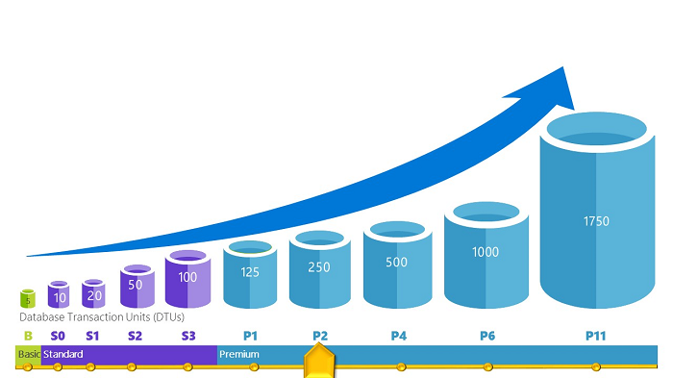
The Database Transaction (Throughput) Unit - DTU
Notes:
https://azure.microsoft.com/en-us/documentation/articles/sql-database-benchmark-overview/

Slide 15
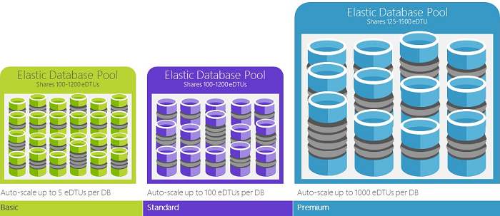

Slide 16
SQL (PaaS) Database or SQL Server on Azure VMs (IaaS)
Azure SQL Database: A SQL database native to the cloud, also known as a platform as a service (PaaS) database or a database as a service (DBaaS) that is optimized for software-as-a-service (SaaS) app development. It offers compatibility with the majority of SQL Server features.
SQL Server on Azure Virtual Machines: SQL Server installed and hosted in the cloud on Windows Server Virtual Machines (VMs) running on Azure, also known as an infrastructure as a service (IaaS).
Details

Slide 17
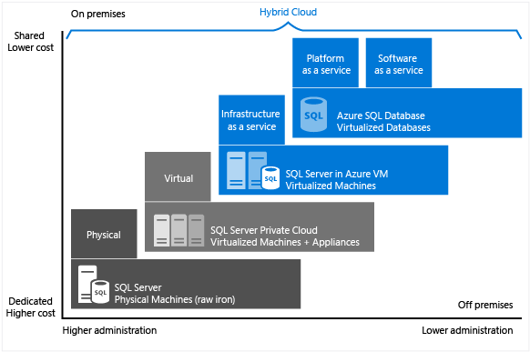

Slide 18
Demos
Azure SQL Database
Create on Portal
Connect and Test some Queries
On Portal
JSON Path
Alerts and Performance Tools
Migrate DB on premises to Azure SQL DB
Write Simple Console App Connecting to Azure SQL DB
Notes:
SELECT * FROM INFORMATION_SCHEMA.TABLES
SELECT * FROM [Course]
for JSON Path

Slide 19
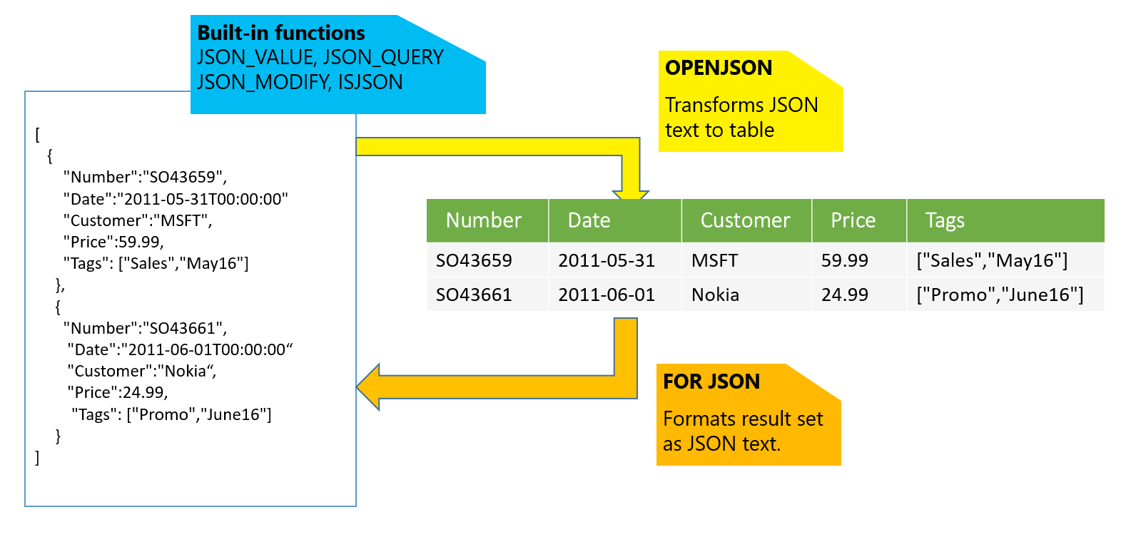
Azure SQL with JSON

Slide 20
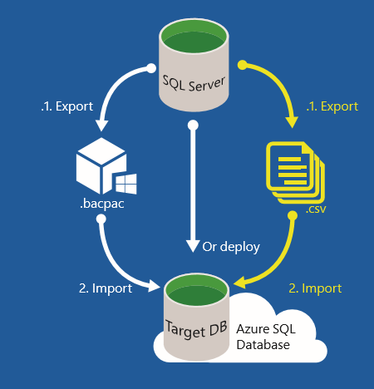

Slide 21
Demos
SQL Database on VM
Create on Portal
Connect and Test some Queries
MS SQL Server Management Studio
MS Visual Studio
Migrate DB on premises to SQL DB on VM
Write Simple Console App Connecting to SQL DB on VM

Slide 22
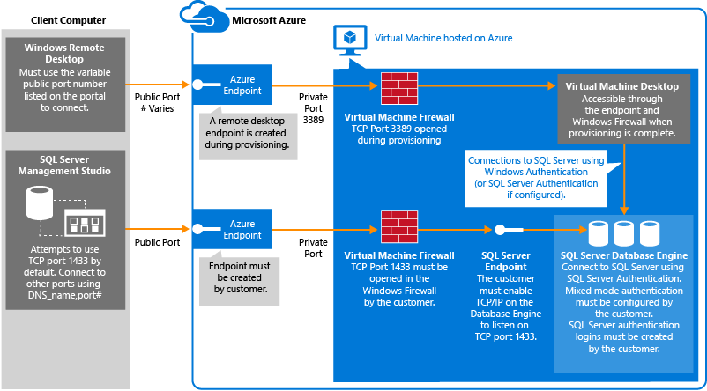

Slide 23
What you lose:
https://azure.microsoft.com/en-us/documentation/articles/sql-database-transact-sql-information/

Slide 24
Azure SQL Pricing
http://bit.do/azure-sql-pricing
Basic, Standard, Premium differences:
Storage capacity
Functionality
Performance
http://bit.do/azure-sql-performance

Slide 25
When would you use Azure SQL?
http://bit.do/azure-sql-expectations (See: “Expectations for Azure SQL Database”)
Key considerations:
Multi-tenancy
Commodity hardware
Tier latency

Slide 26
SQL Database in Azure Assignments
Azure SQL Database
Create on Portal
Connect and Test some Queries
MS SQL Server Management Studio –
MS Visual Studio
On Portal
Migrate DB on premises to Azure SQL DB
SQL Database on VM
Create on Portal
Connect and Test some Queries
MS SQL Server Management Studio
Migrate DB on premises to SQL DB on VM
Report : When To use each one ? (SQL DB in VM vs Azure SQL DB) ---
Self Study : Azure Virtual Networks

Slide 27
Conclusion …
Great for:
startups
departmental apps or non-critical LOB apps
World-wide reach
“Plan B”
Heavy / active development … new features coming online

